Slide 1
Object-Oriented Programming
Module 7

Slide 2
Module Objectives
Explain different O O P concepts and the importance of O O P
Instantiate a class
Describe how to define instance methods and pass arguments to them
Declare class attributes and class methods
Describe how to override methods
Implement multiple inheritance

Slide 3
Lesson 7.1: A First Look at O O P
Object-oriented programming (O O P): Programming paradigm based on concept of objects.
Objects: Capsules of properties and procedures/methods.
Allows us to abstract actual code and think more about attributes of data and operations around data.
Advantages:
Code reusable.
Easier to design software as you can model it in terms of real-world objects.
Easier to test, debug, and maintain.
Data is secure due to abstraction and data hiding.

Slide 4
Lesson 7.2: O O P in Python
Classes are O O P building-blocks.
Blueprints for objects.
Everything in Python is an object.
Running type function on any object will reveal class.

Slide 5
Lesson 7.2.1: Defining a Class in Python
Syntax is minimal.
class ClassName
Running type function shows class type.
In Python, class and type are synonymous.

Slide 6
Lesson 7.2.2: Instantiating an Object
Example: jack = Person()
Each new object instantiated points to different objects.
If we declare a second Person()such as, jill = Person()
jack is jill will be False

Slide 7
Lesson 7.2.3: Adding Attributes to an Object
Can add attributes dynamically.
Type name of object followed by dot (.) and then name of attribute.
Example: jack.name = "Jack Smith"
Try to avoid; this is bad practice.
Every object has built-in attributes.
Such as __dict__
Dictionary that holds all attributes of object.

Slide 8
Lesson 7.2.4: The __init__ Method (1 of 2)
Preferred way to add attributes is by defining them in object’s constructor method.
In Python constructor is __init__
class ClassName
hasattr() function checks whether object has specific attribute or method.
In Python, class and type are synonymous.
Define __init__ just like function and specify attributes that need to be passed when instantiated object.
Snippet 7.13 shows example.
Note: self refers to object we’re in process of creating.
If __init__ defines parameters and you instantiate object without passing argument, you get TypeError.

Slide 9

Lesson 7.2.4: The __init__ Method (2 of 2)
Snippet 7.13

Slide 10
Lesson 7.3.1: Defining Methods in a Class (1 of 2)
Define method in class just like you would __init__.
Can access instance attributes within instance methods.
Snippet 7.22 shows example of creating method, accessing instance attributes within method, and calling method.

Slide 11
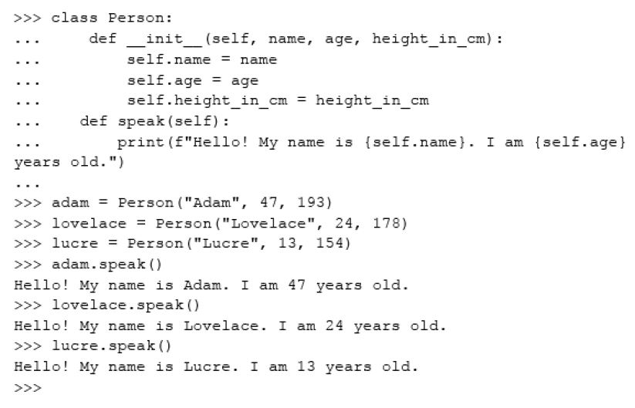
Lesson 7.3.1: Defining Methods in a Class (2 of 2)
Snippet 7.22

Slide 12
Lesson 7.3.2: Passing Arguments to Instance Methods
Can pass arguments to instance methods, just like normal functions.
Can add condition statements to instance methods.

Slide 13
Lesson 7.3.3: Setting Instance Attributes within Instance Methods
Can add instance attributes to instance methods.
Same process as adding attributes to __init__.

Slide 14
Lesson 7.4: Class versus Instance Attributes
Instance attributes are bound to specific instance of the class.

Slide 15
Lesson 7.4.1: Class Attributes (1 of 2)
Class attributes are bound the class and shared by all instances.
Syntax is just like defining variable, only you do it in the class body.
Snippet 7.33 shows example.
Access class attribute via class itself.
Changing class attribute through class will reflect on all existing instances.
Changing class attribute through instance will create instance attribute.
Can access and change class attributes in instance methods.

Slide 16

Lesson 7.4.1: Class Attributes (2 of 2)
Snippet 7.33

Slide 17
Lesson 7.5.1: Creating Instance Methods (1 of 2)
Instance methods must receive self as first argument.
Don’t need to explicitly pass in value for self.
Bound method: One that takes an instance (self) as first parameter.
Every instance of class has its own copy of method.
Snippet 7.49 shows instance method examples.

Slide 18
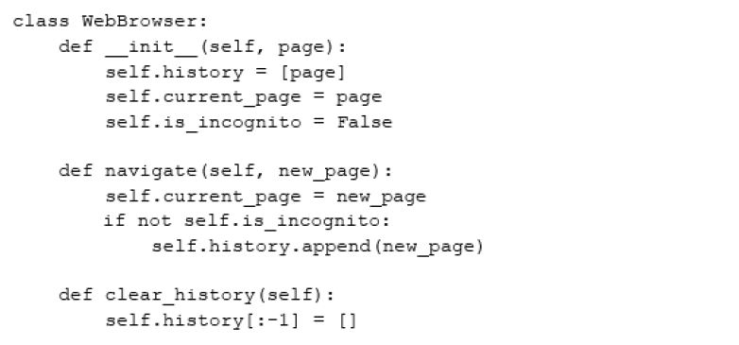
Lesson 7.5.1: Creating Instance Methods (2 of 2)
Snippet 7.49

Slide 19
Lesson 7.5.2: Class Methods (1 of 3)
Class methods are bound to class itself and not instance.
Do not have access to instance attributes.
Called through class; don’t require creation on instance.
First parameter is always class itself.
First argument is reserved.
Convention is to use name cls.

Slide 20
Lesson 7.5.2: Class Methods (2 of 3)
Common use is for making factory methods.
Factory methods are ones that return objects.
Can be used to return objects of different types.
See Snippet 7.52 for class method example.
Function definition starts with @classmethod.

Slide 21
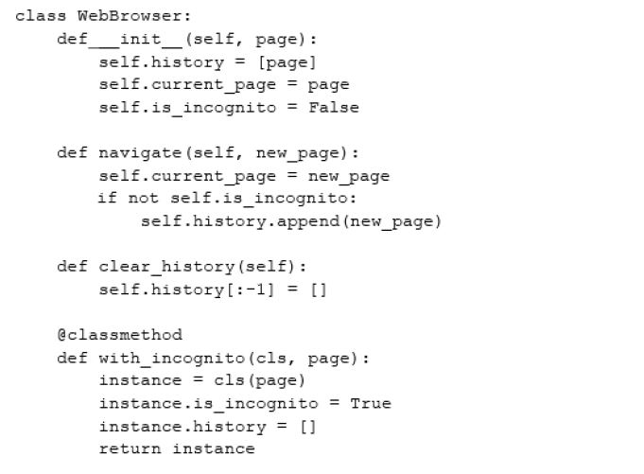
Lesson 7.5.2: Class Methods (3 of 3)
Snippet 7.52

Slide 22
Lesson 7.5.3: Encapsulation and Information Hiding
Encapsulation: Bundling of data with methods that operate on that data.
Used to hide internal state of object.
Information hiding: Hiding of internal state of object.
Used to abstract away irrelevant details about class to prevent users from changing them.
In Python, accomplished by marking attributes private or protected.
private: only used inside class definition and not accessed externally.
Prefix attribute name with double underscore.
Attribute inaccessible outside of class.
protected: similar to private, but only used in very specific contexts.
Prefix attribute name with underscore.
Interpreter doesn’t enforce restrictions, this is just marker letting users know not to access outside of class.

Slide 23
Lesson 7.6: Class Inheritance
Inheritance: Allows for class’s implementation be derived from another class’s implementation.
Subclass/derived/child class inherits all attributes and methods of superclass/base/parent class.
Benefits:
Makes code more reusable.
Makes it easier to extend functionality.
Adds flexibility.
In Python define class as usual but pass the base class as parameter.
Syntax: class Subclass(Superclass):

Slide 24
Lesson 7.6.1: Overriding __init__()
Overriding: Redefining the implementation of a method defined in superclass to add or change subclass’s functionality.
Can override __init__ to add attribute to subclass.
Use super method to access inherited methods from parent class that have been overwritten in child.

Slide 25
Lesson 7.6.2: Commonly Overridden Methods
Dunder or magic methods: Special methods prefixed and suffixed with double underscores.
Examples:
__init__
__str__
__del__
Commonly overridden to customize class.

Slide 26
Lesson 7.6.3: The __str__() Method
Every object has __str__ method by default.
Called every time print is called.
Override to customize string containing readable representation of object.

Slide 27
Lesson 7.6.4: The __del__() Method
__del__ is destructor method.
Called whenever object gets destroyed.
Might want to override to print message to user.

Slide 28
Lesson 7.7: Multiple Inheritance
Allows you to inherit attributes and methods from more than one class.
Commonly used for mixins.
Mixins: Classes that have methods/attributes that are meant to be used by other functions.
Example: Logger class has log method that writes to logfile, and when added to your class as mixin gives it that capability.,

Slide 29
Summary
In this module:
We have begun our journey into O O P.
O O P makes code more reusable; it makes it easier to design software; it makes code easier to test, debug, and maintain; and it adds a form of security to the data in an application.
The behaviors of an object are known as methods, and you can add a method to a class by defining a function inside it.
To be bound to your objects, this function needs to take in the argument self. We also covered class attributes and class methods in detail.
We also took a look at encapsulation and the keywords that enable information hiding in Python.
Information hiding is used to abstract away irrelevant details about the class from users.
We saw how to have a derived class inherit from a single base class, as well as multiple base classes.
We also saw how to override methods: specifically, the __init__, __str__, and __del__ methods.

